Slide 1
National Investing Strategy (by county)
Strategy Plan 2025

Slide 2
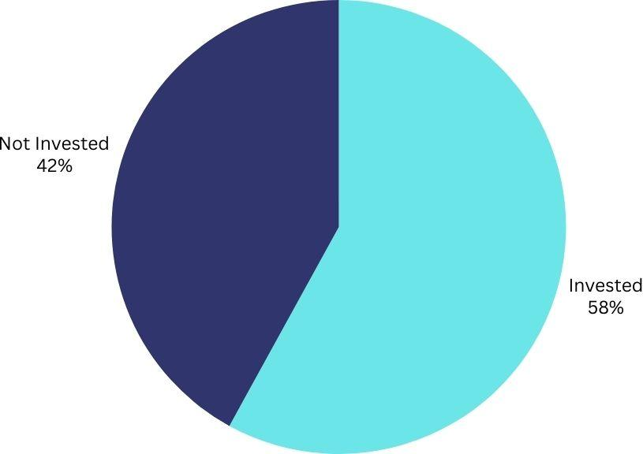
Market Size
2024 Schwab Modern Wealth Survey: 58% of Americans are currently investing.
Federal Reserve: Same proportion of American households own stocks.

Slide 3
How should banks that are looking to expand into locations across the country offer their products?
(by county)

Slide 4
VARIABLES
Age
Inflation Rate by county
Determines Risk Tolerance and Investment Horizon: Younger people have a longer investment horizon, allowing them to make higher-risk investments
Older people prefer stability and predictable income
Influences the Need for Inflation-Protected Investments: High inflation erodes cash value, making it essential for people to invest in assets that can outpace inflation.
Education
Income
Affects Financial Literacy and Investment Preferences: Higher education levels correlate with higher financial literacy.
Lower education levels often lead to a preference for safer investments.
Determines Investment Capacity and Risk Tolerance: Higher-income individuals have more discretionary income.
Lower-income individuals typically prioritize liquidity and security.

Slide 5
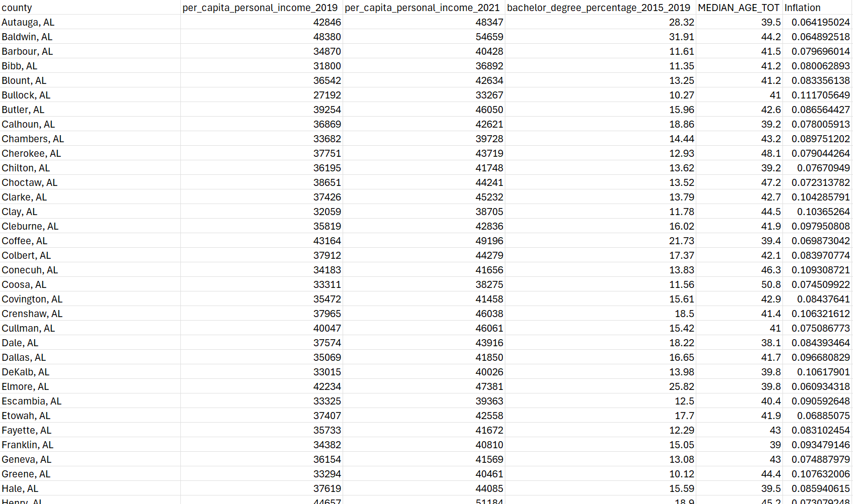
Data Gathering/Preprocessing
Downloaded multiple datasets from government sources.
Edited them in excel.
Used SQL to find and filter out bad data and join tables to form one master dataset with all relevant attributes.
Minor modifications to fix remaining errors.

Slide 6
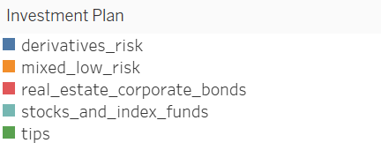
Legend
This is the legend for our graphs.
Blue for risky securities
Orange for mixed low-risk securities
Red for real estate securities and corporate bonds
Teal for stocks and index funds
Green for tips

Slide 7
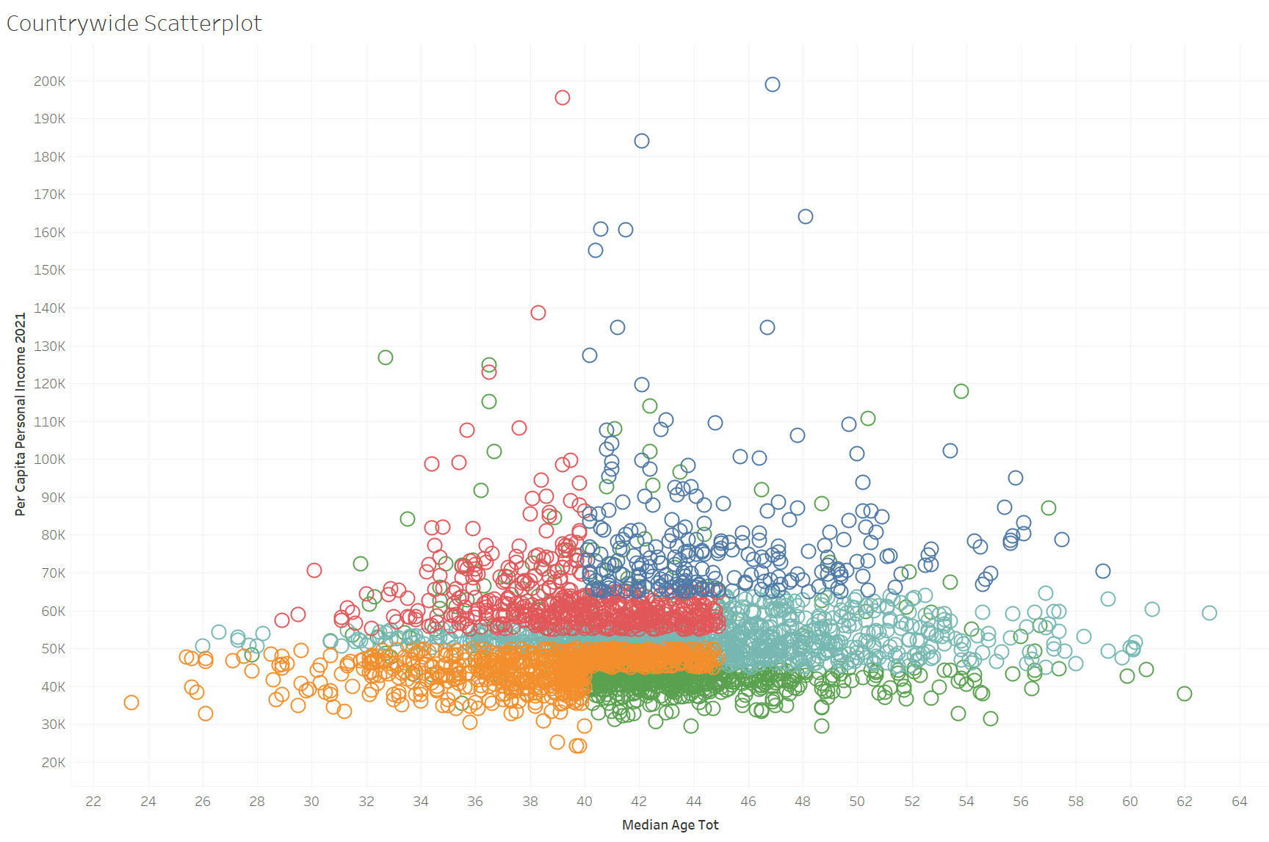
Decision Making
How we approached the situation is we came up with 5 generic investing strategies. Those were stocks and index funds, TIPS, derivatives and riskier securities, mixed low risk, and corporate bonds/ real estate/ HYSAs. Provided is a scatterplot of median income vs median age, color coded by investment strategy.
Stocks and index funds: A general strategy suitable for the average person.
TIPS: Ideal for those closer to retirement or living in regions with lower costs of living and inflation, as TIPS can outpace local inflation and protect purchasing power into retirement.
Derivatives and riskier securities: Best for those who are educated and have significant capital, as they provide the highest potential returns on average, with an understanding of the associated risks.
Mixed low-risk securities: Recommended for young individuals with low income, as they leverage time as an asset and provide lower risk while still offering protection.
Corporate bonds, real estate, and HYSAs: Suitable for younger individuals with more money and education, offering a high return over time with a medium level of risk, and requiring knowledge and resources to navigate these investments.

Slide 8
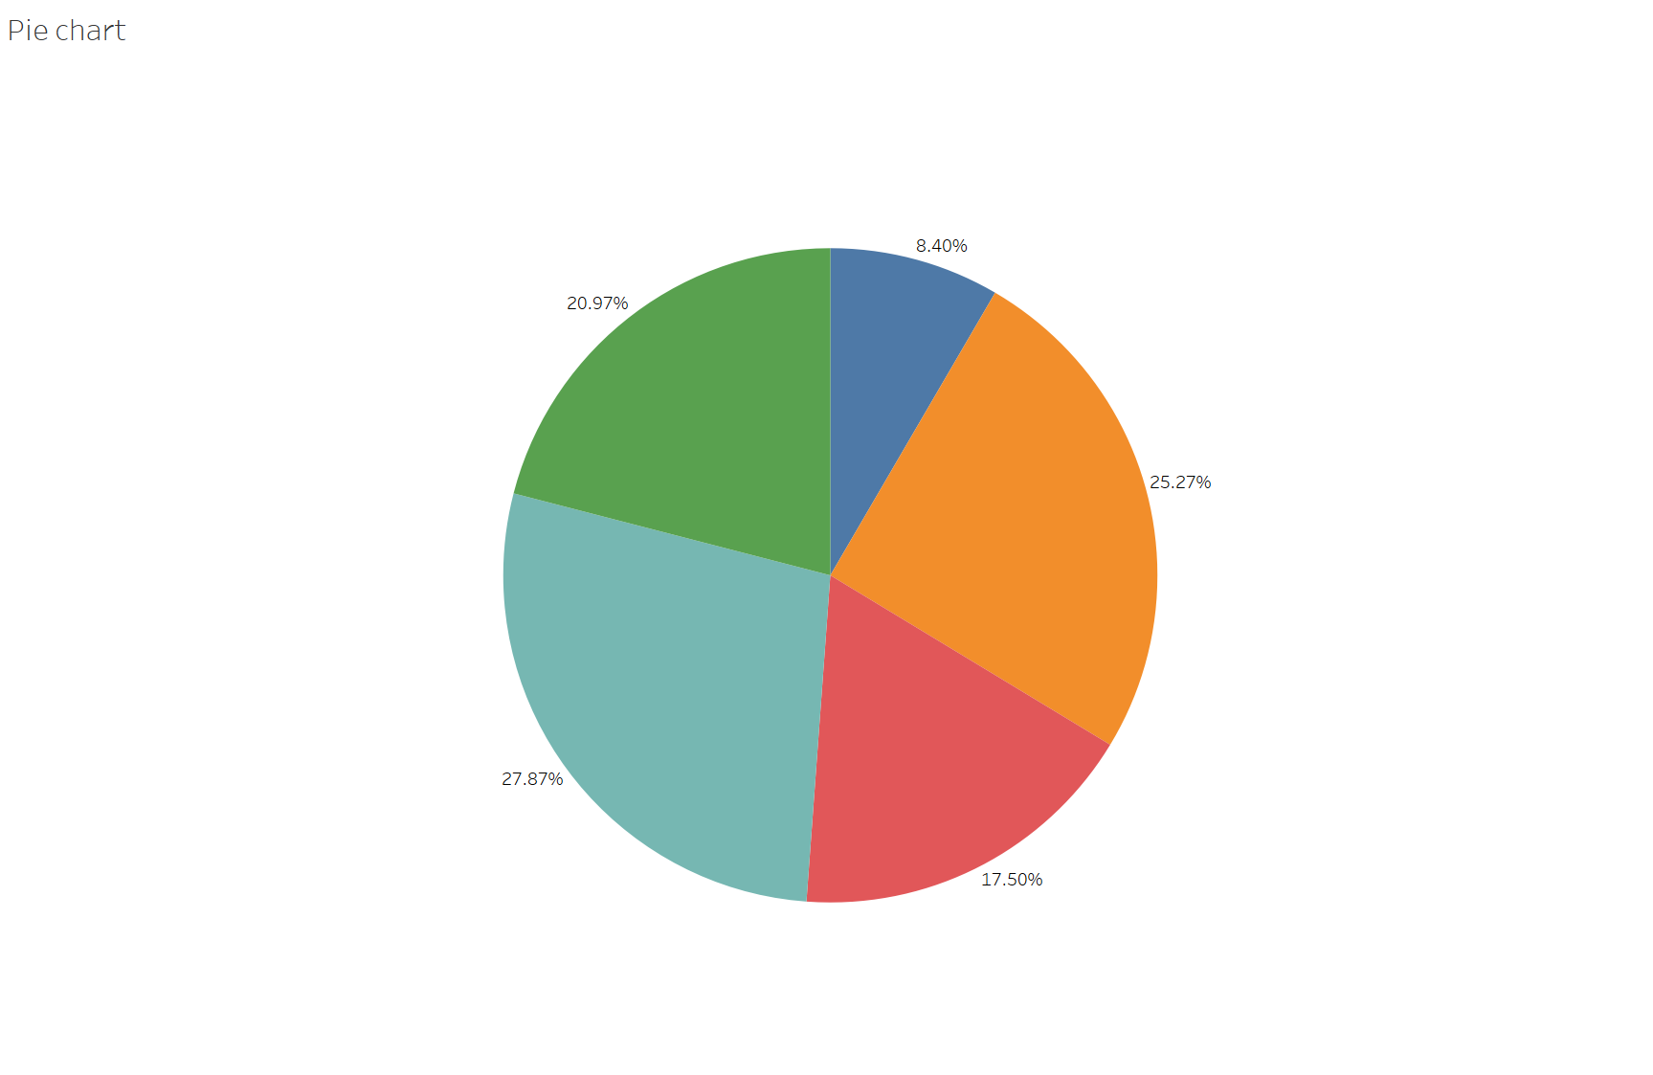
Total Offerings Breakdown
This is a pie chart of the percentage each strategy is recommended.
Across the entire country and including all ages, we have:
27.9% Stocks & Index Funds
25.3% Mixed Low Risk
21% TIPS
17.5% Real Estate Corp. Bonds
8.4% Higher Risk/Derivatives
Reflects the majority of the population being middle age and and middle-low income.

Slide 9
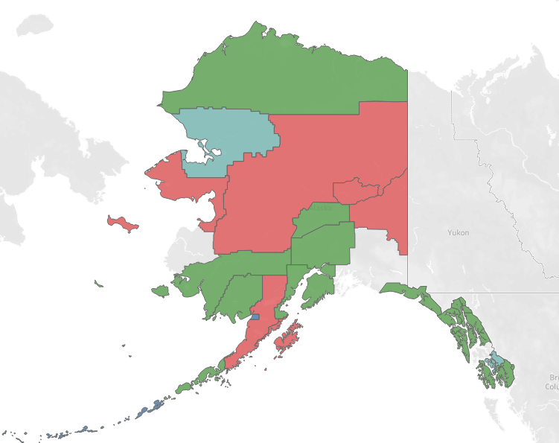
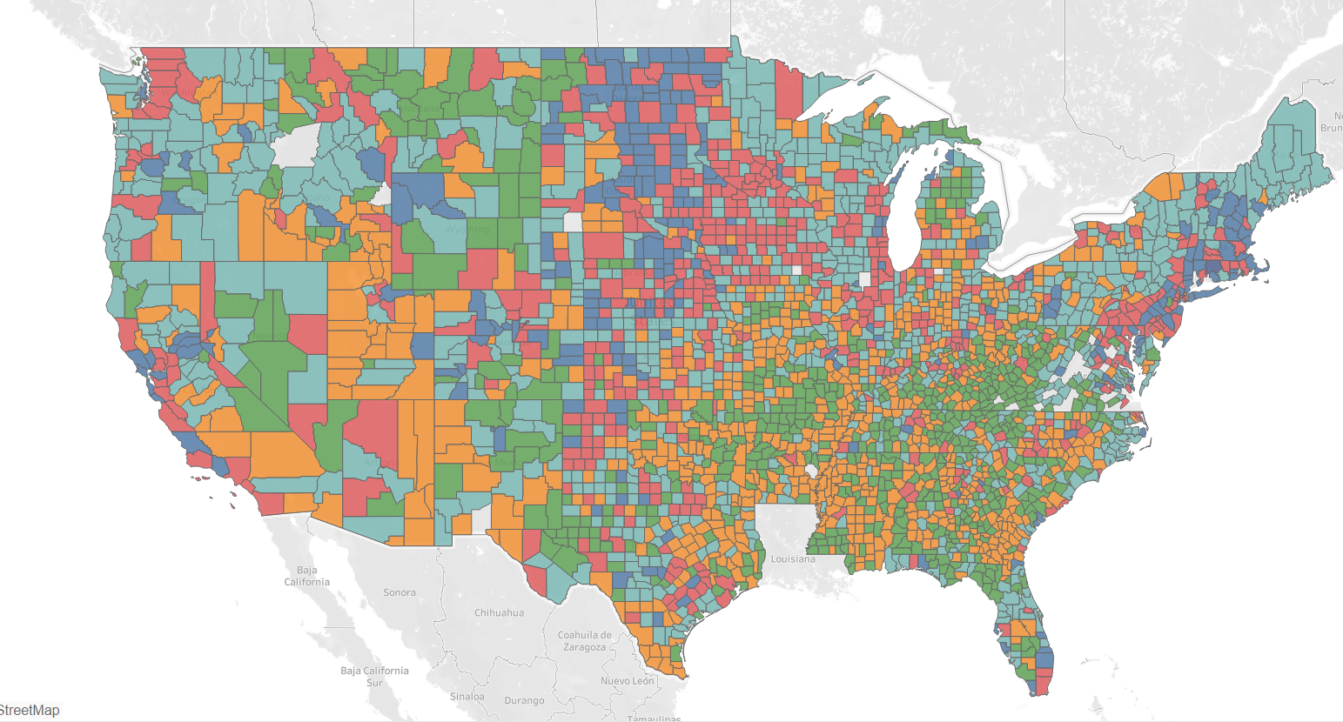
Geospatial plot
This is a geospatial plot of (almost) every county in the US and what the suggested investment for every one of them is.
We see lots of TIPS and mixed low risk strategies in the “east” midwest. Across the northeast, best option is for stocks and index funds. Lot of derivatives strategies in NJ!

Slide 10
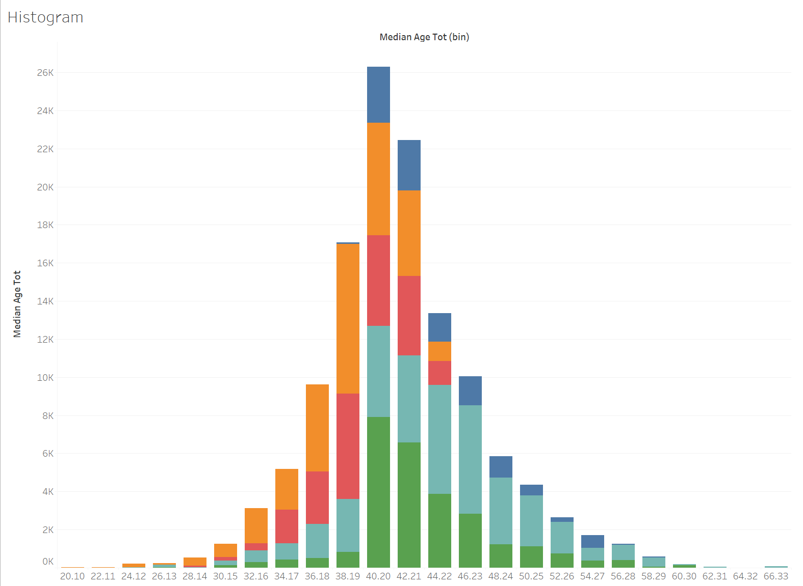
Demographic Explanations
As one approaches middle age, the percentage invested in Real Estate increases before sharply decreasing again (less time, more money).
Derivatives appear quickly at age 40 and consistently decline (Money & experience, less time)
Low-risk securities increase until middle age (time is an ally).
TIPS are best for those planning to retire (protects purchasing power).
Stocks & Index Funds are great at all times, reflective of their average size for all ages (never largest, always staple)

Slide 11
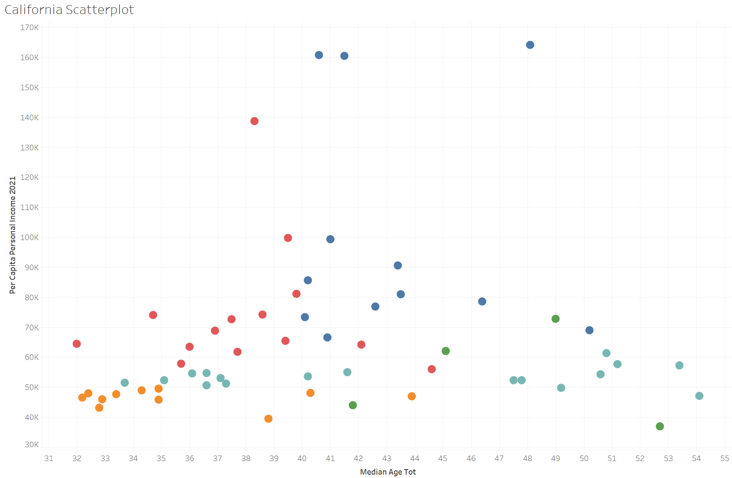
Ex: California

Slide 12
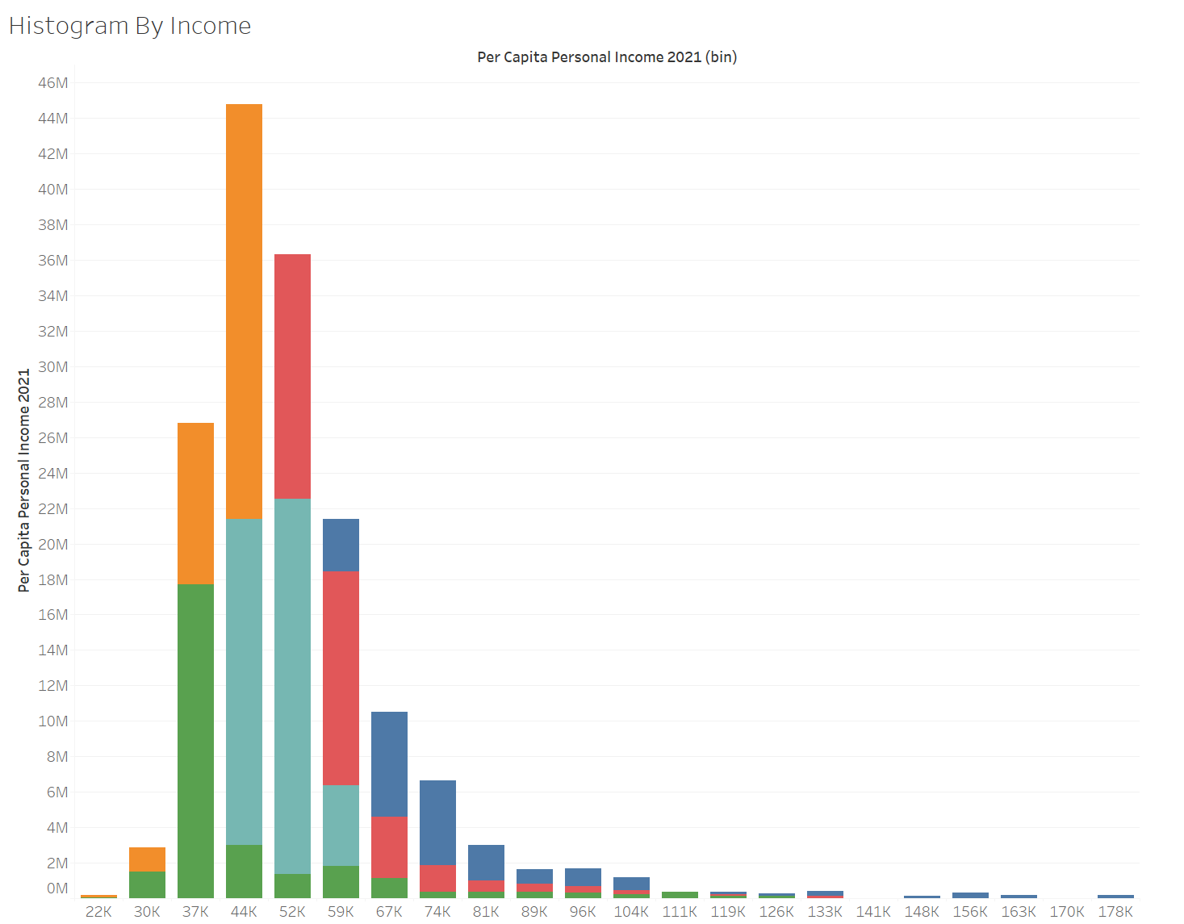
Histogram by Income

Slide 13
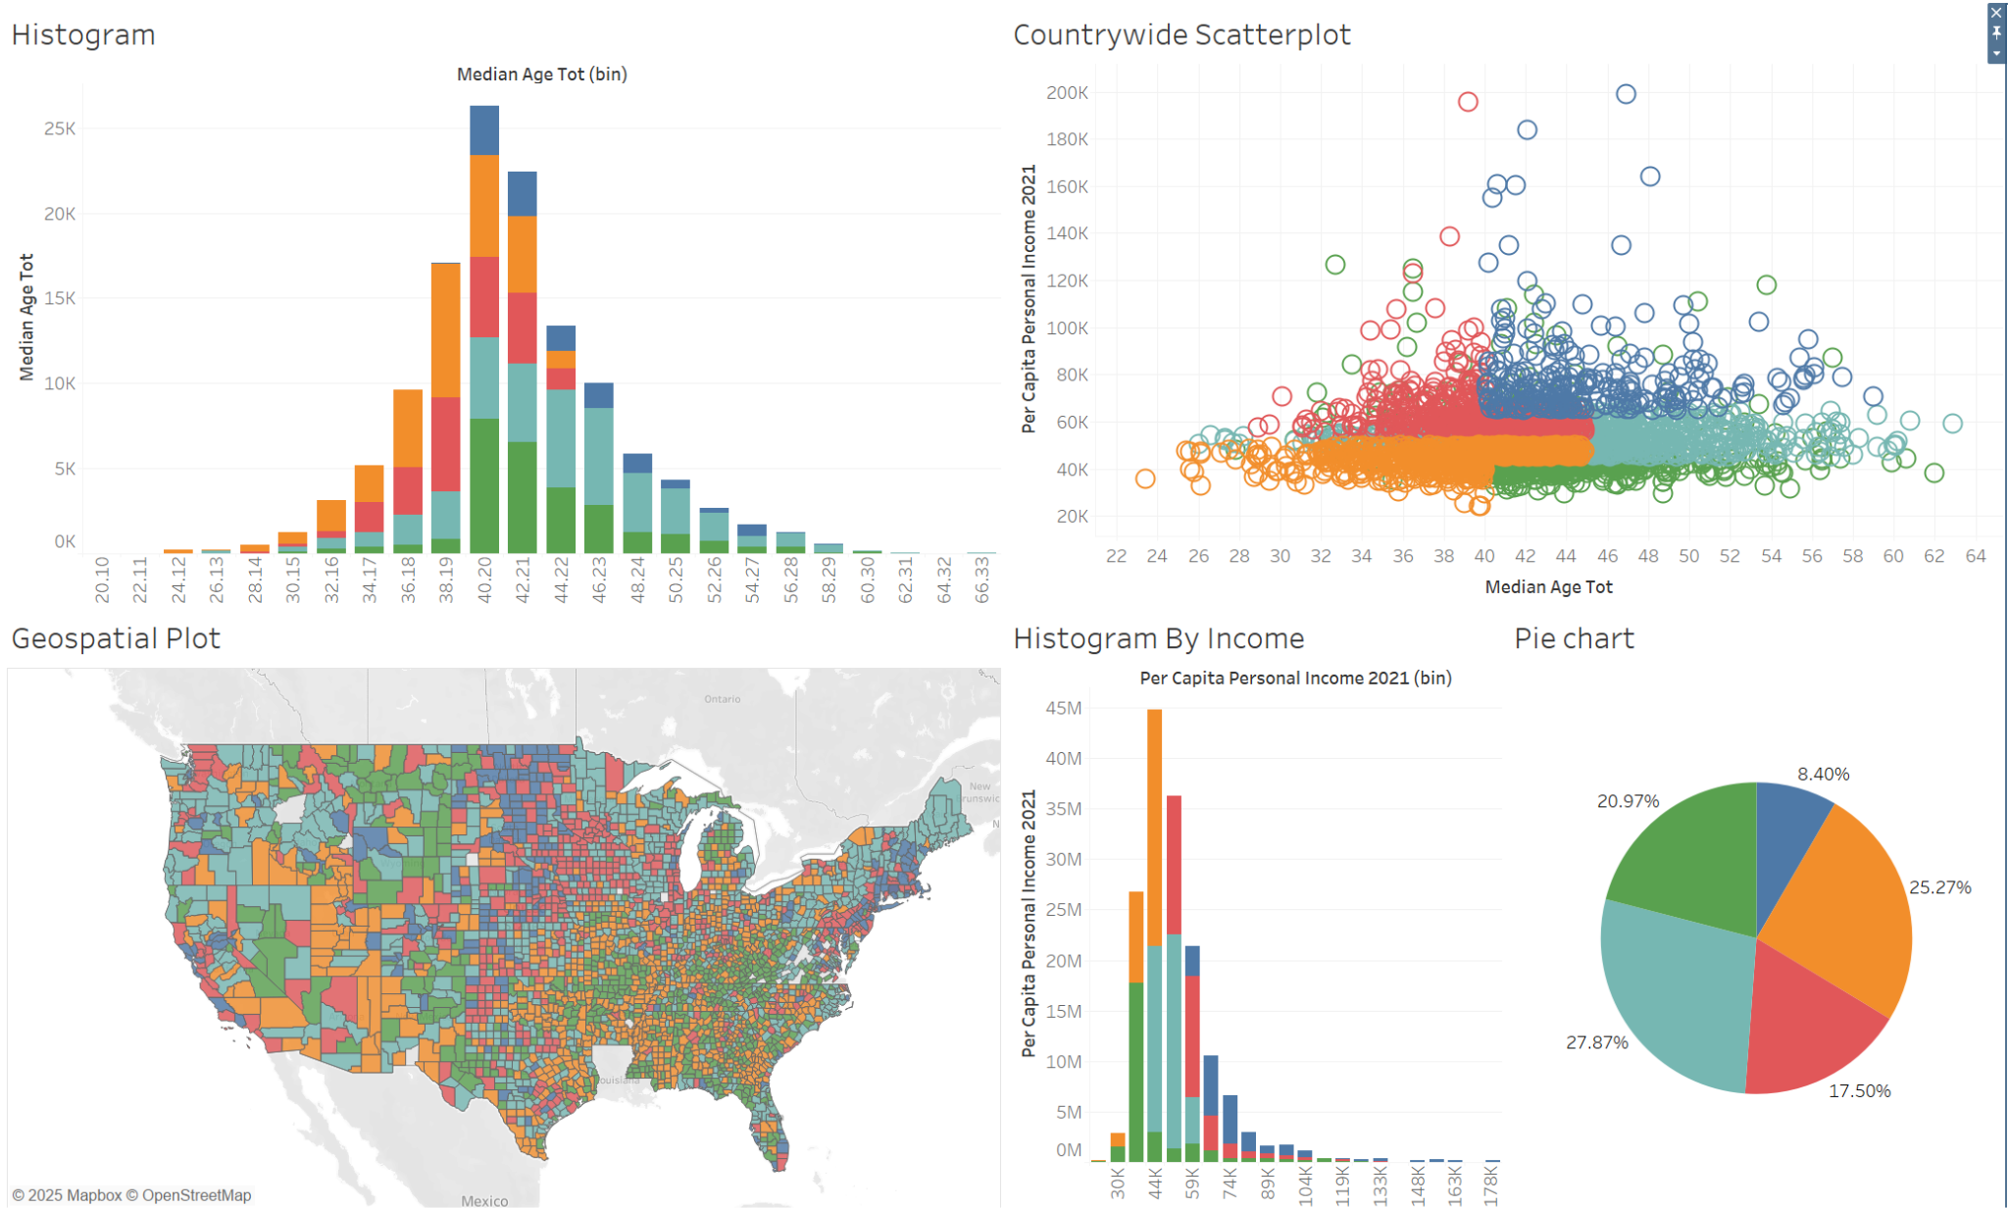
Dashboard

